Slide 1



LummatAI Smart Traps for Controlling Harmful Insects (STCHI) with advanced Algorithm optimization.
AI-powered Pest Control Solution
Developed by STCHI Groupe Innovation
Presented by: Mohammed Belhachemia
https://lummat.sirraf.com

Slide 2

Project Overview
The Lummat AI project uses AI to find pests and smart water control to make farming more efficient. that connects to solar-powered hardware like a camera, AI algorithms, and a battery management system. It can find pests in real time, control irrigation based on soil moisture, and send information to a mobile app so you can keep an eye on things from afar. The system gets better at finding pests and using water more efficiently all the time by using machine learning. The solution is made for places that aren't connected to the grid. It provides automated, eco-friendly, and battery-efficient farming management. Lummat's main goals are to be environmentally friendly.
Visit the link ! https://blog.inttect.org/blog/lumman-revolutionizing-agriculture-with-ai-powered-insect-detection-project

Slide 3
Project Overview
- Project Name: LummatAI - Smart Traps for Controlling Harmful Insects
- Technology: AI-powered traps that use pheromones, cameras, and AI to detect pests
- Target Audience: Farmers, agricultural cooperatives, government agencies, NGOs.
B2C and B2B.
Intellectual Property (IP) Status:No

Slide 4

Team
Name: Belhachemia Mohammed Ibrahim
Role: Founder & Technical Project Lead
LinkedIn: linkedin.com/in/ibrahim-mohammed-fr
Main Responsibilities
Project Leadership: Oversees the entire innovation process from concept to prototype and market strategy.
AI Integration: Selects and integrates AI models into software and hardware platforms for intelligent pest detection and prescription analysis.
Hardware Prototyping: Designs the system architecture, including the embedded edge devices (smart traps, AI-powered wearables, etc.).
Software Architecture: Leads backend and frontend development for mobile/web platforms; ensures a scalable and secure system.
UX/UI Design: Creates inclusive and accessible interfaces tailored to low-literacy users and non-digital populations.

Slide 5

Problem Statement
- Farmers lack early and accurate pest detection tools.
- Manual monitoring is time-consuming and error-prone.
- Overuse of pesticides causes environmental damage and increased costs.
- No accessible AI-based pest monitoring systems locally.
-Ineffective spraying schedules due to absence of pest population insights.
-No integration with mobile alerts for early pest warnings..

Slide 6

Our Solution
- 1-AI-powered smart traps that attract pests using pheromones and AI cameras named Lummat
- 2-Real-time pest monitoring with data analysis via mobile app or dashboard.
- 3-Solar-powered solution for cost-efficiency in remote areas. Optimized for daily use using AI agent for detect and suite the usage of our Hardware.
- 4-Reduces pesticide use and increases crop protection
5-Smart water management systems adjust irrigation and humidity levels to create unfavorable conditions for pests, protecting crops while conserving resources.

Slide 7

Core Value
- Economic:Saves money on pesticide usage and labor costs
- Ecological:Reduces chemical spraying through targeted interventions
- Technological:Introduces AI and IoT in agriculture in rural and underserved areas
- Operational:Real-time, solar-powered, and low-maintenance solution

Slide 8

Prototype & Technology
- Hardware Components:
- Pheromone dispenser, camera module, solar panel, and sensors
- AI Integration: Real-time insect identification using TensorFlow Lite
- Connectivity via Wi-Fi, LoRaWAN, or GSM
- Powered by solar energy, making it sustainable for remote areas

Slide 9
Business Model Canvas
- Customer Segments: Smallholder farmers, agricultural cooperatives, government agencies
- Value Propositions: Real-time pest detection, solar-powered, low-maintenance, eco-friendly
- Revenue Streams: Hardware sales, subscription for analytics, B2B partnerships
- Channels: Direct sales, agricultural expos, partnerships with distributors

Slide 10

Market Overview
- Target Market: Global agriculture market, especially in pest-prone regions
- Competitive Advantage: AI-powered detection, solar integration, and real-time data reporting
- Opportunities: Global scaling, partnerships with agritech firms, integration with drones and weather prediction systems

Slide 11
Financial Overview
- Initial Investment: 25,600,000 DZD for hardware, AI model development, and testing
- Revenue Forecast (Year 1): 2,000,000 DZD to 3,000,000 DZD
- Device Price: 30000–35000DZD with optional analytics subscription
- Projected Growth: Expanding to 1,000 clients in Year 2

Slide 12

Timeline & Milestones
- Phase 1(Months 1–6): Hardware & software development
- Phase 2 (Months 7–12): Pilot testing on farms, Benchmarks and analytics.
- Phase 3 (Year 2): Market launch and scaling
Extra Time for Contract and contracts with legal practice from governements

Slide 13
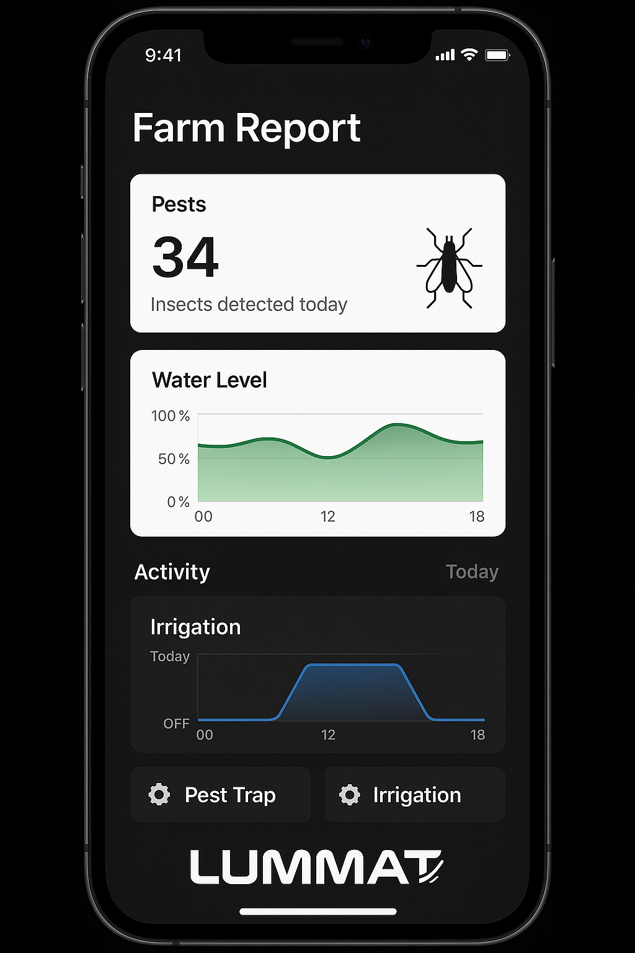
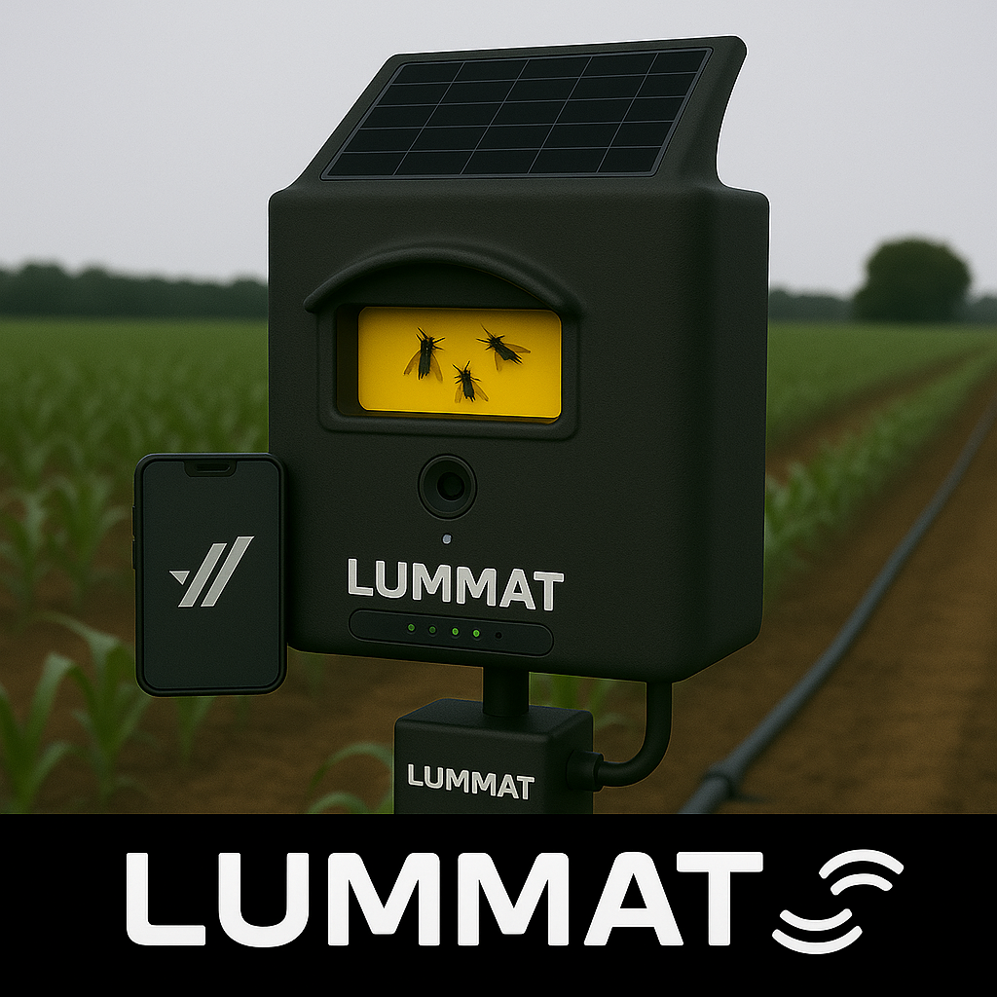
Prototype Model & Demo
Visit!https://lummat.sirraf.com/demo/
Images of prototype models and real-world testing
WIFI
OR BLEUTHOOTH CONNECTION SUPPORT

Slide 14

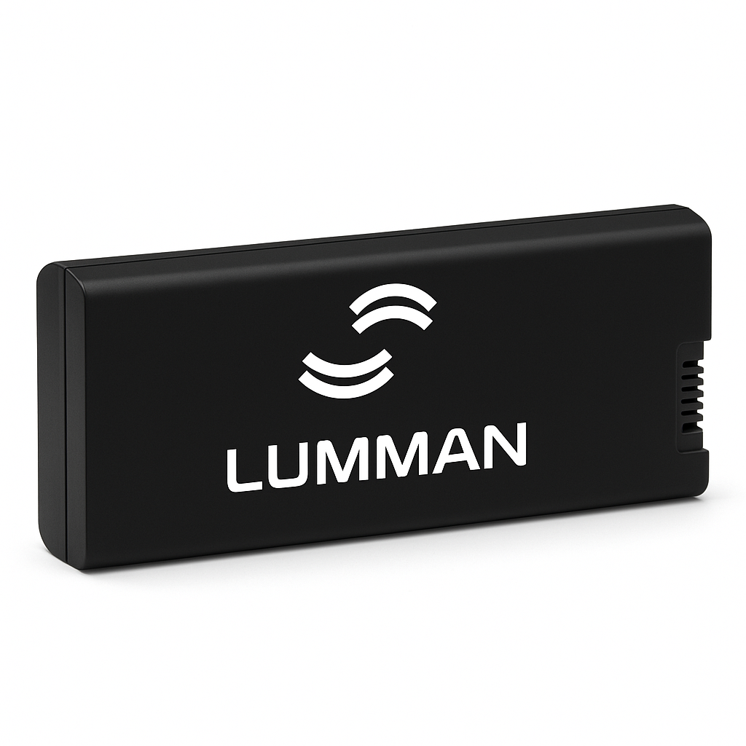
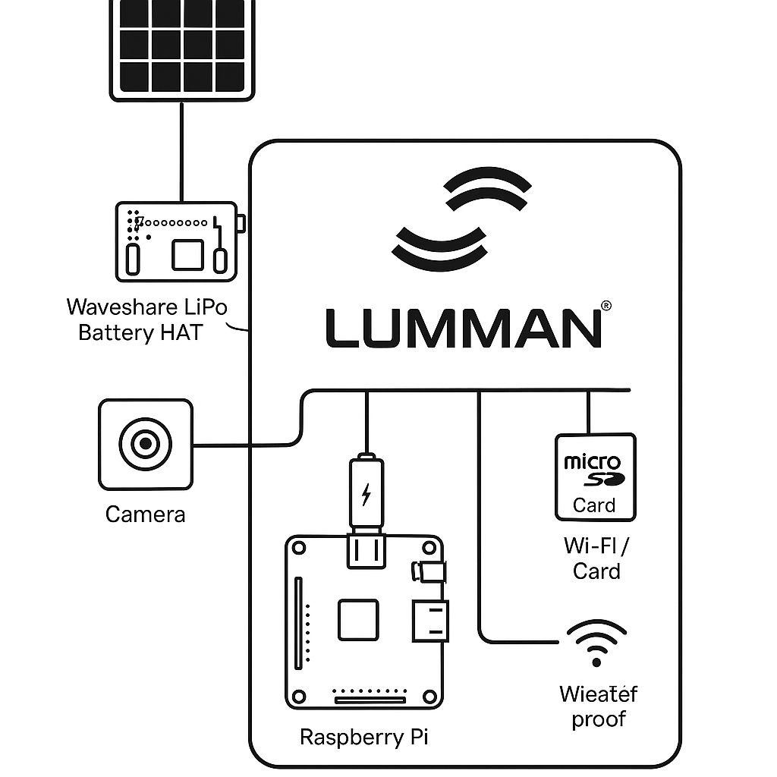
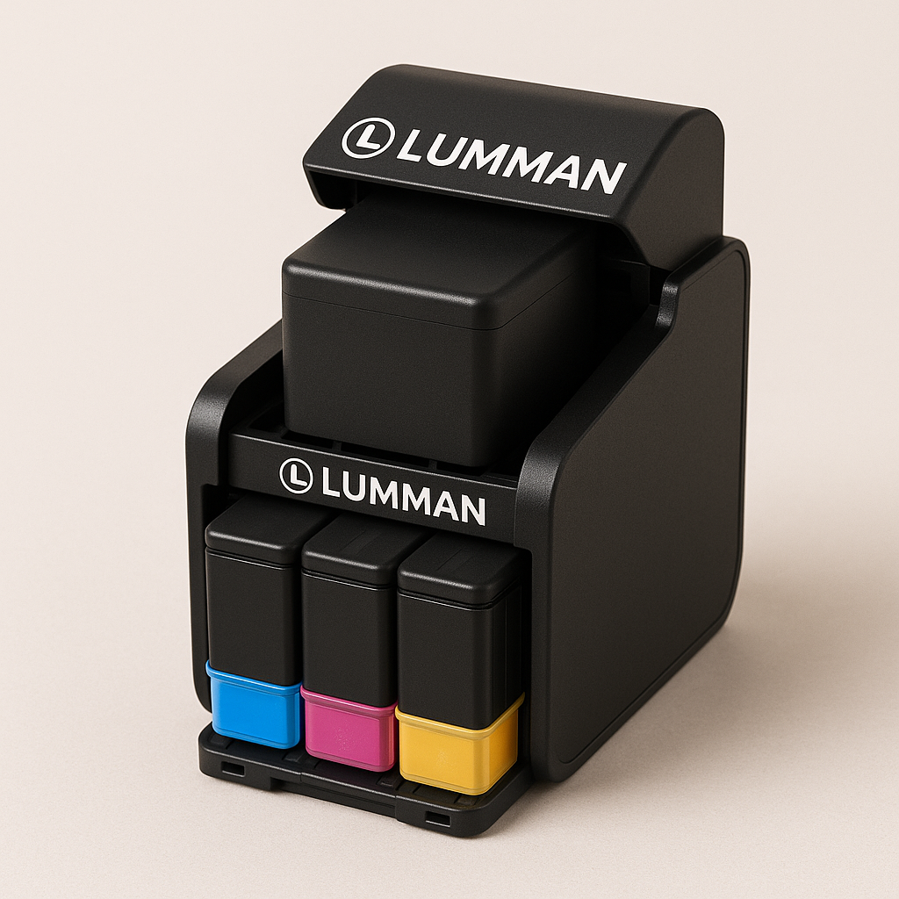
Compenent Demo ready
READY SMART BVATTERY WITH OUR DEVICE
PHEREMONES CARTGIES

Slide 15
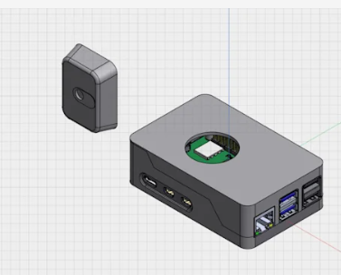
Hardware 3D model
(solide-works)

Slide 16

Key Challenges & Mitigation
- Challenge 1: Hardware optimization and scaling production.
- Mitigation: Focus on cost-effective manufacturing and prototyping.
- Challenge 2: AI model accuracy in variable environments.
- Mitigation: Extensive testing and model fine-tuning.

Slide 17





Competitive Analysis
- Competitors: Basic electronic traps, manual systems, expensive pesticide-based methods
- STCHI Advantage: Real-time AI detection, solar-powered, scalable solution
LIST OF COMPITITORS (2025)

Slide 18
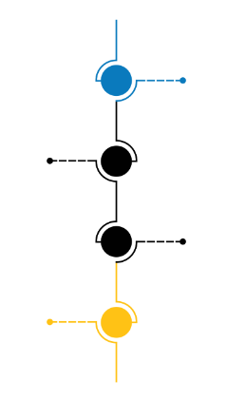
SWOT Analysis
Strengths:
Weaknesses:
-
Opportunities:
- Potential for global scaling
Threats:
- Traditional traps, supply chain issues
Check SWOT ANALYSIS page 24
Visit the link
AI Integration: Uses machine learning or computer vision to detect and classify
pests automatically
Solar-Powered Hardware: Operates independently
of grid power, ideal for deployment in remote or off-grid
agricultural zones.
Offline Capabilities: Can function without constant internet connection.
Early Prototype Phase: Limited field validation and.
High Initial Setup Cost: Compared to basic non-AI traps,
Maintenance Requirements: Camera traps and sensors may need periodic

Slide 19

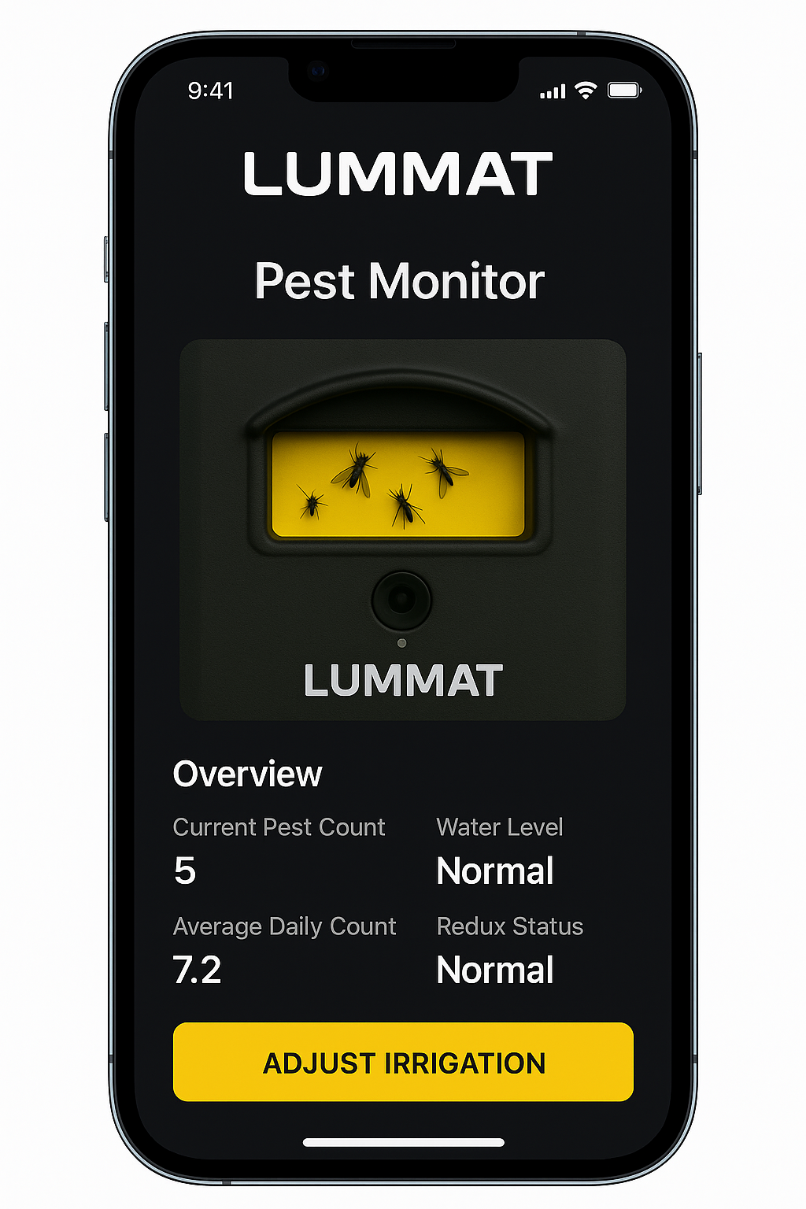
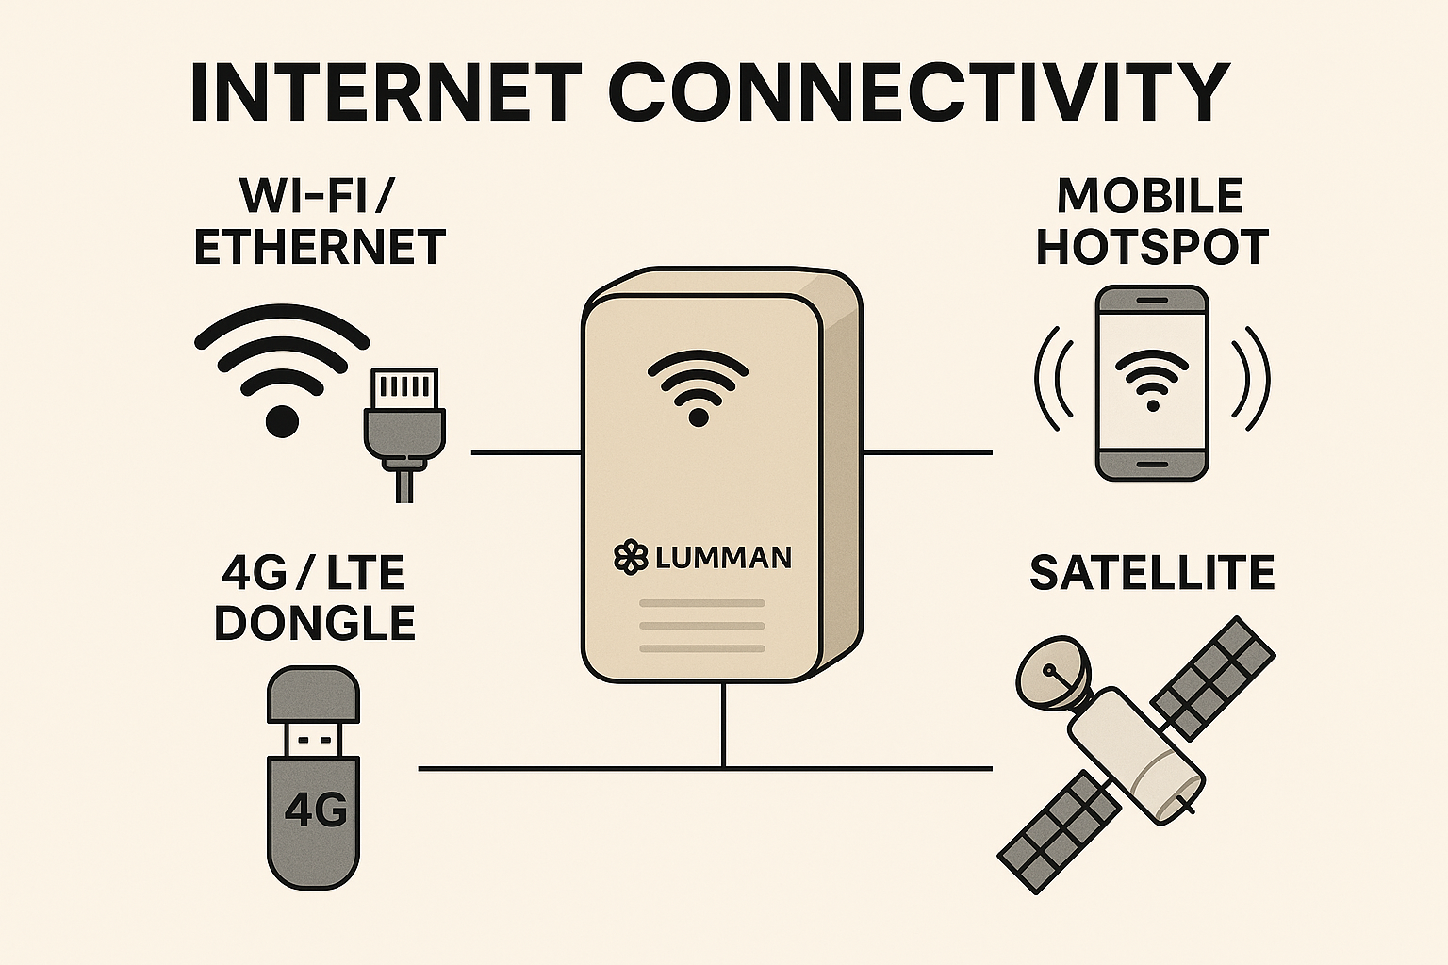
SMART FARM CONNECT

Slide 20

Our company require
1. Technical Resources
Hardware Engineers: To refine the physical design of the smart trap, improve durability
AI/ML Developers: To train and optimize pest detection models, anomaly detection
Embedded Systems Developers: For firmware development and device-level optimization
IoT/Backend Engineers: To scale cloud infrastructure, device data ingestion, and real-time dashboards.
2. Market Access & Partnerships
Pilot Projects: With farms, cooperatives, NGOs, or environmental agencies to test
and validate the solution.
Government or NGO Partners: For large-scale rural deployments, subsidies,
or data-sharing agreements.
3.Financial Support
Seed Funding or Grants: For scaling prototype to commercial production.
Operational Budget: To support salaries, field testing, manufacturing, and logistics.
Funding for Certifications: Including CE/FCC marks, agricultural device certifications,
or environmental compliance.
4- Manufacturing & Supply Chain
Production Partners: For manufacturing trap enclosures, solar modules, sensors, and AI chips at scale.
Component Suppliers: Stable and affordable access to cameras, microcontrollers, batteries, and solar panels.
Logistics Network: To distribute, install, and maintain smart traps in rural or widespread areas.

Slide 21

Revenue Model and Projections
- Revenue Streams: Hardware, subscriptions, partnerships.
- Projected Year 1 Revenue: 2,000,000DZD to 3,000,000DZD
- Target Clients Year 1: 100 farmers or Coperatives.

Slide 22
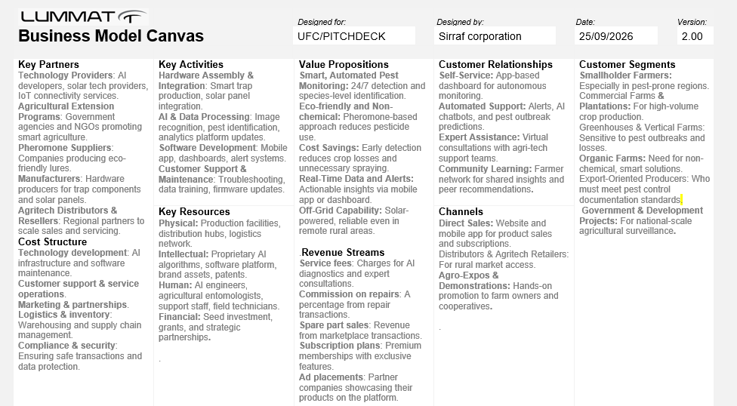
BMC LUMMAT AI PROJECT

Slide 23
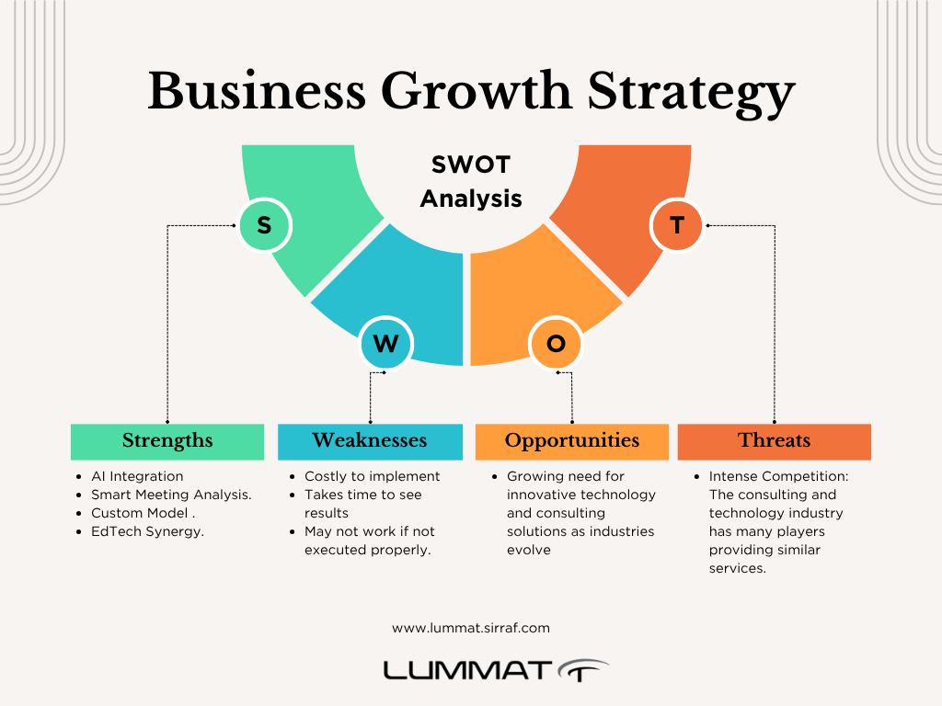
SWOT ANALYSIS

Slide 24
LINKS AND CONTACT
LINKEDIN FULL STARTUP :https://www.linkedin.com/company/lummatai
FOUNDER LINKEDIN:https://www.linkedin.com/in/ibrahim-mohammed-fr/
TEAM :BELHACHEMIA MOHAMMED IBRAHIM
MAIL:mail@inttect.org
Or visit https://blog.inttect.org/contact

